Slide 1

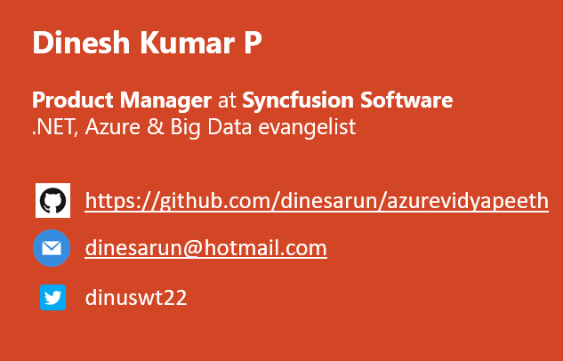
Big Data and Business Intelligence
Notes:
Good evening guys. Ya. I am Dinesh Kumar. Product Manager at Syncfusion Software. I manage ‘Web data sources’ division of Data Platform team. And am pretty happy to be here for this session today.

Slide 2

Agenda
Where does ‘Big Data' fit in 'Data Science' world?
What would be a day to day routine work of a Data Scientist?
A quick demo + sample use cases of BigData projects like Hadoop, Spark, HBase and Hive.
Importance of Business Intelligence and Visualization with a quick demo using "Syncfusion Dashboards”, a SaaS based BI tool.
Notes:
Can see as story that revolves around the work of a data engineer.
Big Data - is not actually about technology or Software, its THINKING. That also differs case by case and even among companies.

Slide 3
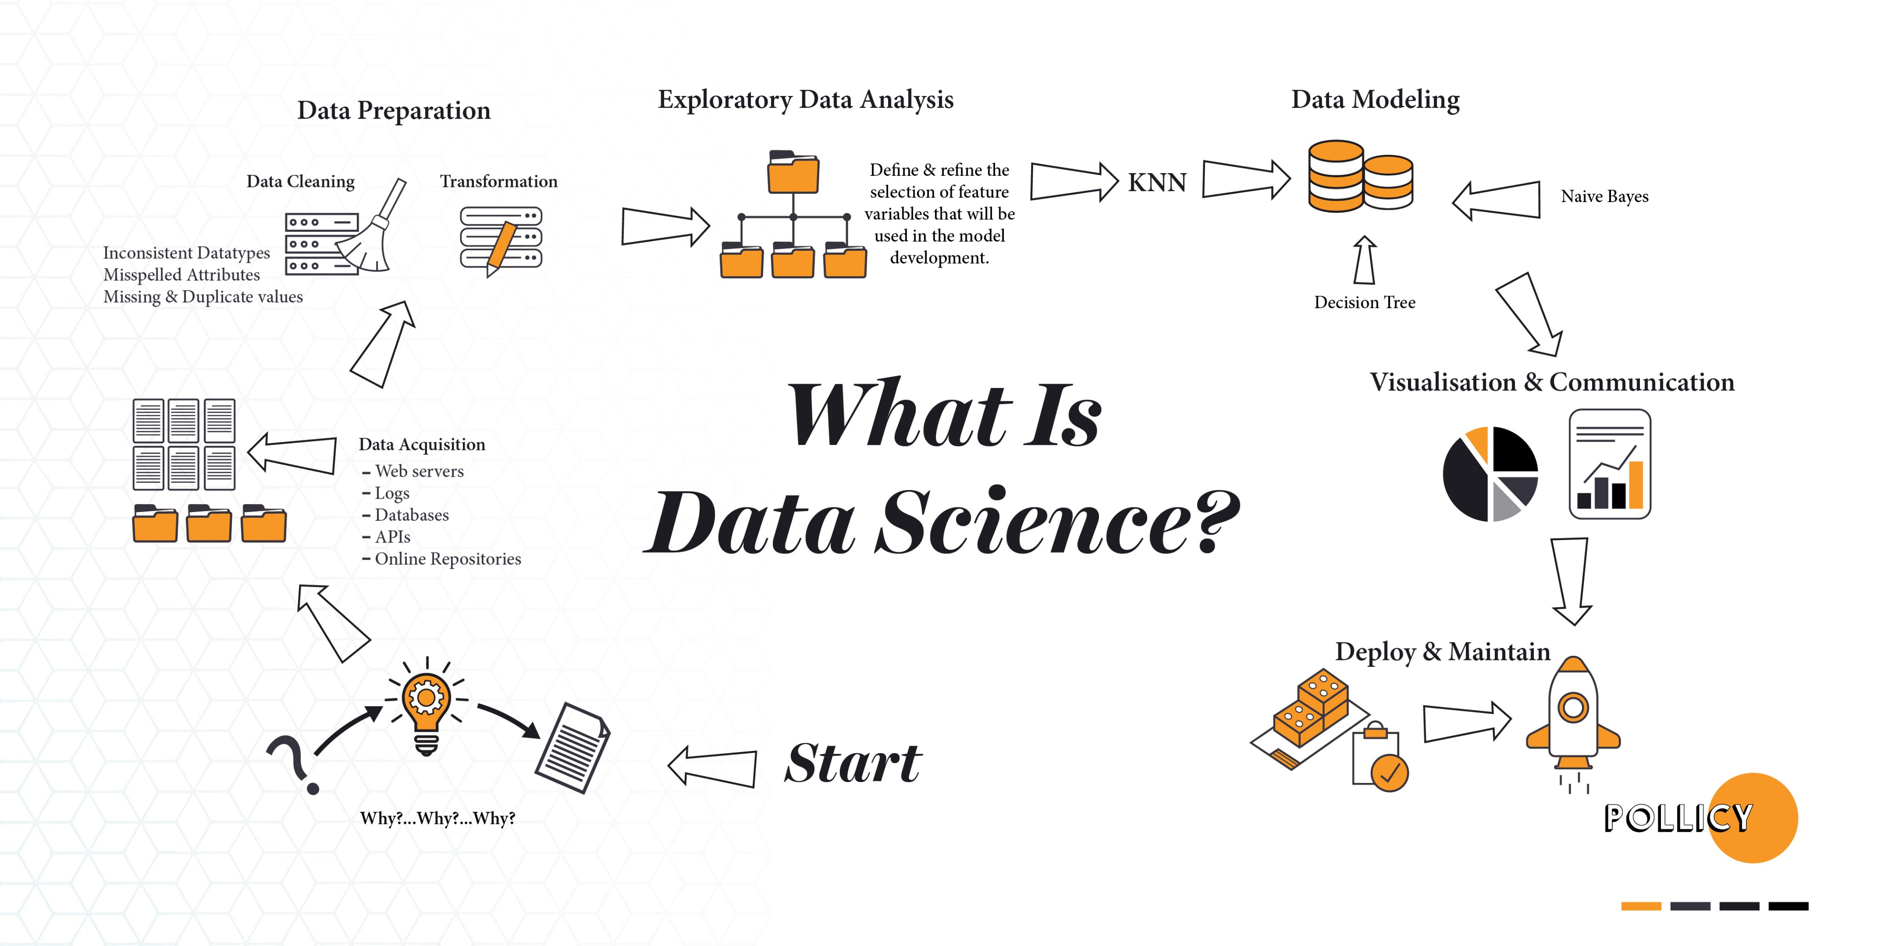

Slide 4
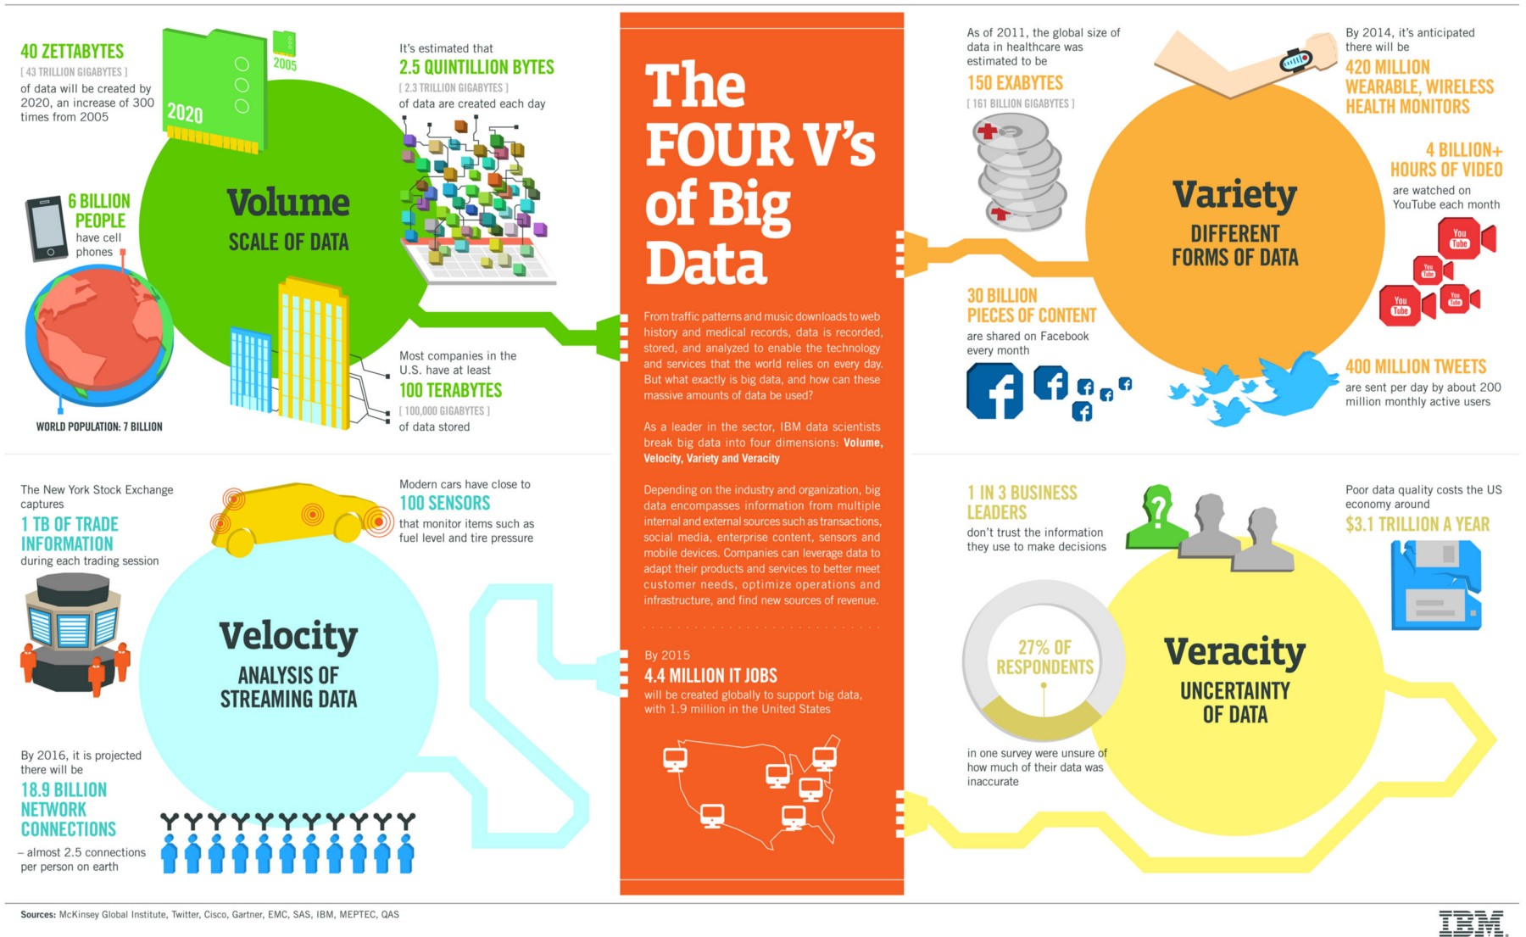
Notes:
Not only for Big Data, can be told for Data science as well.
Velocity will directly impact Volume.
Even though its 1 TB and its velocity is very less, plus the data is of Flat type, then RDBMS itself is a best choice.

Slide 5
Domains, Industries
Marketing
Sales and CRM
Web Analytics
Ecommerce
Advertising
IT
Finance
Healthcare
Social Media
SEO
Banking
Human Resources
Mobile Analytics
Project Management
Research and Development
Support
Survey
Insurance
Manufacturing
Energy
Oil & Gas
Pharmaceuticals
Public Sector
Retail
Communications
Food and Beverages
Education
Media
Technology
Transportation and Logistics
Notes:
Different domains now a days produces different KINDS of data. Upon which all cannot be fit into traditional SQL based database systems.

Slide 6
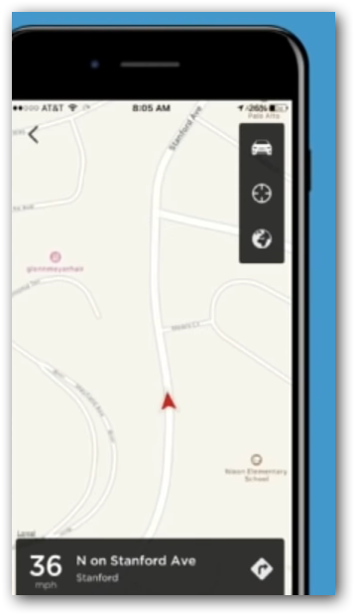
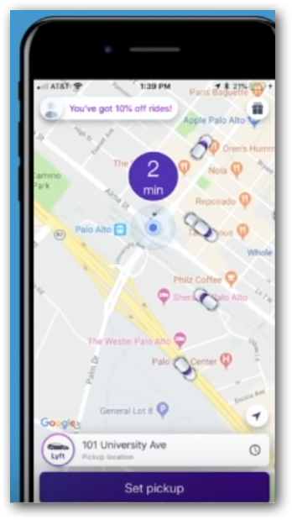
Which one a user would Like?
Where is my driver?
2. When will my driver get here?
Notes:
Data science – With the history of gbs or tbs of trip data, bring up some fact / model that can predict the approximate time
Big Data – Use that model in each and every trip and show the value to user. i.e. Real VALUE that a customer expect.

Slide 7
SQL
Vertically Scalable.
Increase the load on a single server by increasing things like CPU, RAM or SSD.
Adding more floors to the same building.
NoSQL
Horizontally Scalable.
Can handle more traffic by sharding, adding more servers.
Adding more buildings to the neighborhood.
Notes:
Sharding
Splits large data sets into small data sets across multiple instances.
E.g. Hadoop - distributed cluster architecture.

Slide 8
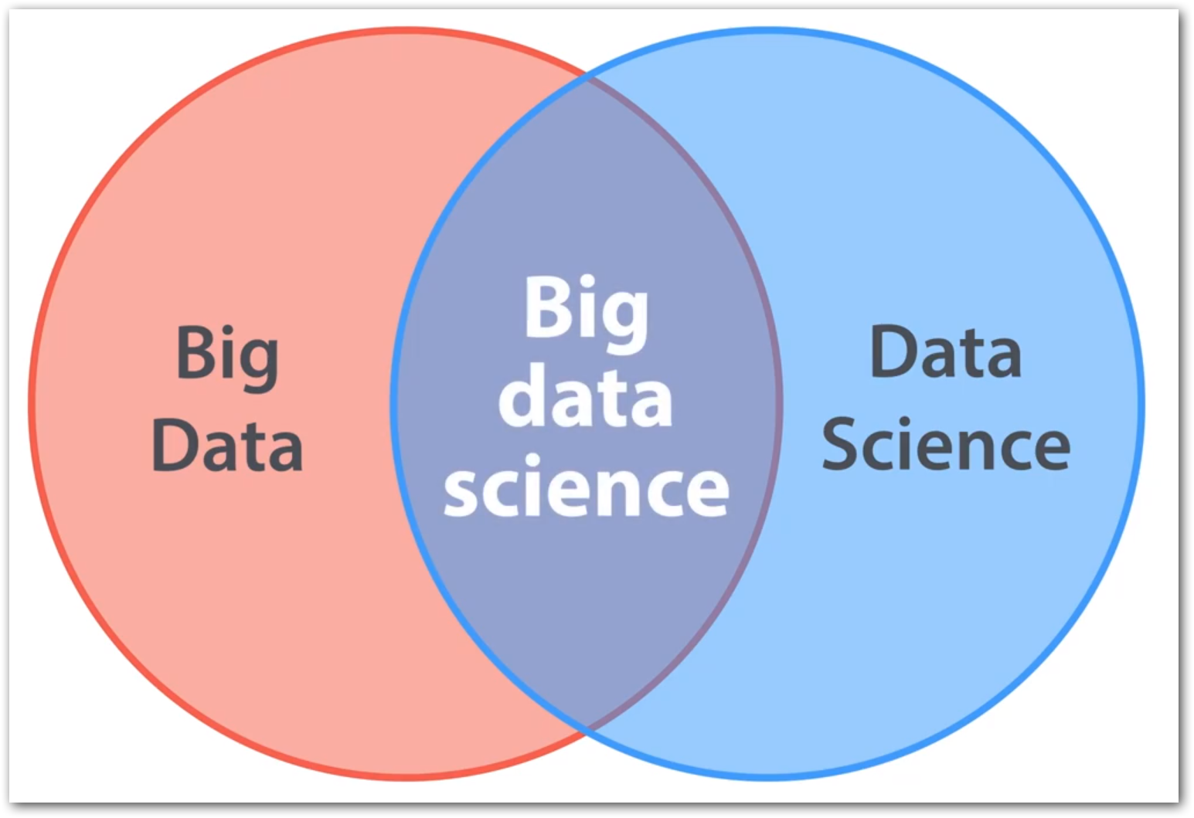
Big Data vs Data Science
Big Data + Data Science = Big Data Science
Big Data ≠ Data Science
Big Data -> All 4 Vs
E.g. Shares trade, E-Shopping
Data Science -> 1 V
E.g. ML use cases like Genetics data, Credit card fraud detection – Volume

Slide 9
Which one a user would Like?
Where is my driver?
Just real time.
When will my driver get here?
Real time combined with historical data.
The Business (winning) touch.
Notes:
Data science – With the history of gbs or tbs of trip data, bring up some fact / model that can predict the approximate time
Big Data – Use that model in each and every trip and show the value to user. i.e. Real VALUE that a customer expect.

Slide 10

Why Big Data?
No use of storing data alone, unless we derive some information out of it.
For a business to run successfully - not only its historical data, now a days current data also is necessary.
Showing Recommendation in e-commerce sites.
Cost reduction via commodity hardware.
Empowers to make better decisions analyzing more about their work.
Hadoop – Lot of ecosystem built around it including Spark-HDFS.
Notes:
Cost reduction - Big data technologies such as Hadoop and cloud-based analytics bring significant cost advantages when it comes to storing large amounts of data. (On-premises - Commodity Hardware)

Slide 11
Why BigData?: SQL Comparision
Hadoop | SQL
Schema on Read | Schema on Write
Master Slave | Client Server
Data stored as like the form of file itself (txt, csv, mp3,…) or compressed form (RC, parquet,..) | Stored as logical forms and inter related columns
Distributed processing across 1000s of nodes. | Not much cluster size at most.
Need to do a lot of effort for quick, real time response that require huge data as well. | Can expect response in milli seconds
E.g. Twitter Hashtag search happen over 1000 servers, ok if miss some tweets due to unavailability of 1 of 60 nodes | E.g. Transaction(Banks), Share market
Notes:
Spark will not suit for 100 MB / 1 GB data
Same way you cannot easily process a semi-structured / un-structured / no-sql data in RDBMS.

Slide 12

Use case
A transportation network company.
Grown over the years through acquisition of many small transportation companies - hence, it doesn’t have a single, consolidated view of their customer base, trip details…
Also details are fragmented among many subsystems, product lines -
Ride, Drive, Freight
Food delivery,
Outstation,
etc.…
So plans to build a single data lake.
Data scientists, Data Engineers, BI analysts.
Finally it is to generate insights.
Notes:
UBER – Takes over Ola, Red Taxi, Fast track…
Different file formats.
Different reporting tools.
Different data types to store Trip details, Phone calls, Logs, Feedbacks.

Slide 13

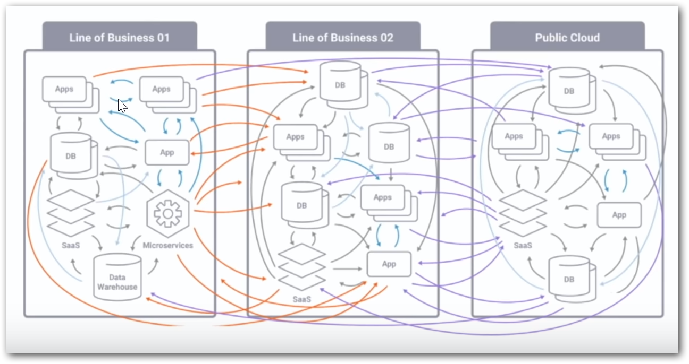

Slide 14
Data engineer’s routine work
2. Identify source(s) of Data
4. Storage & Access
5. Processing
6. Visualization
3. Data Integration
1. Defining Objective

Slide 15

1. Defining Objective
Understand the domain & industry,
Discuss about the business need / problem,
Ask more and more WHYs?
Prepare the objectives.

Slide 16
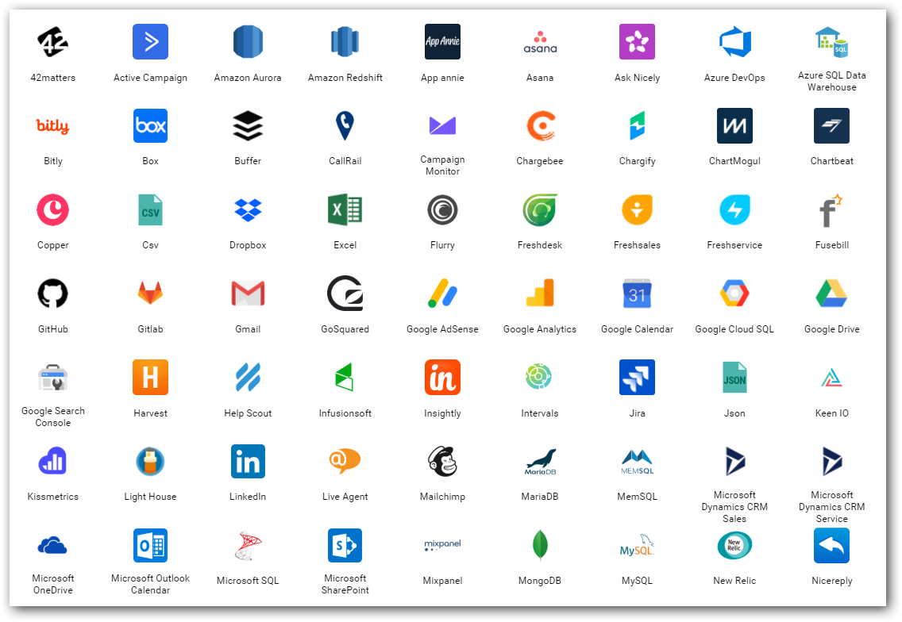
2. Data source(s)
Find out from where you need to get the data for your project.
Either provided or should search and find.
Logs
Databases
Web (REST APIs)
Social Media
…
Notes:
Logs – NASA logs which we gonna process.

Slide 17
3. Data Integration
Required data would exist in different sources those need to be brought to one place for,
Gather
Clean
Prepare
Tools
Apache Sqoop
Informatica
Apache Nifi…

Slide 18
4. Storage & Access
Different stages
Initial
Processing
Final
Instances & Services
Cloud Database instances (SQL Server, MySQL,..)
Amazon S3
Azure Blob / Azure Data Lake…
Access
API
Integration between processing tools

Slide 19
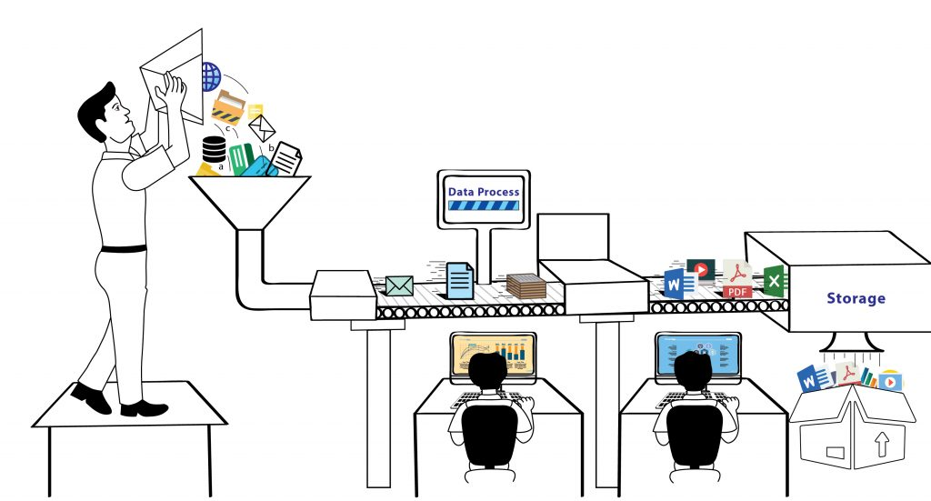
5. Process
Analyze / Do Analytics
ML models
Map Reduce
Tools & Services
Apache Pig / Hive / Spark
Amazon Sage Maker
Azure HDInsight / Databricks / ML Studio

Slide 20
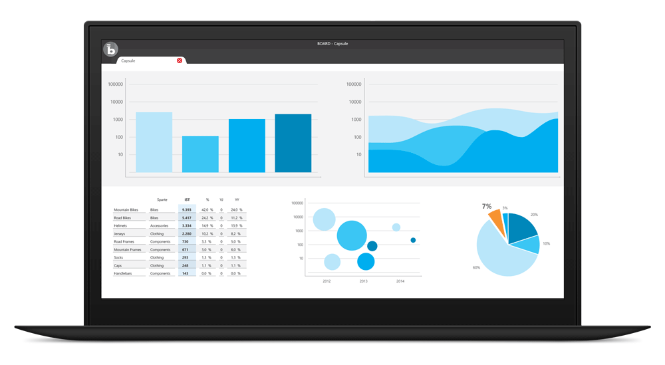
6. Visualize
BI tools for business decisions
Microsoft Power BI
Tableau
Qlik
Bold BI
…
In-built packages in R, Python
Notes:
Most important.
This is how the top cream layer gets the view of their business that leads to decisions.

Slide 21
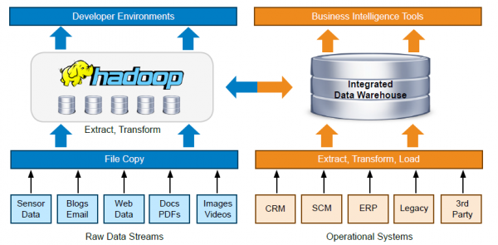
Notes:
A typical tool set and workflow architecture of a Data team

Slide 22

Importance of Business Intelligence and Visualization
How to convey your boss with data in Excel with thousands of rows?
Just convey it as a bar chart / pie chart.
Transform the data into charts, images,… that explain the numbers and allow us to get insights from it.
Meaning and purpose to the original data.
See the story that lives in your data.
Discover patterns (HISTORY), metrics (CURRENT) and spot trends (FUTURE).

Slide 23
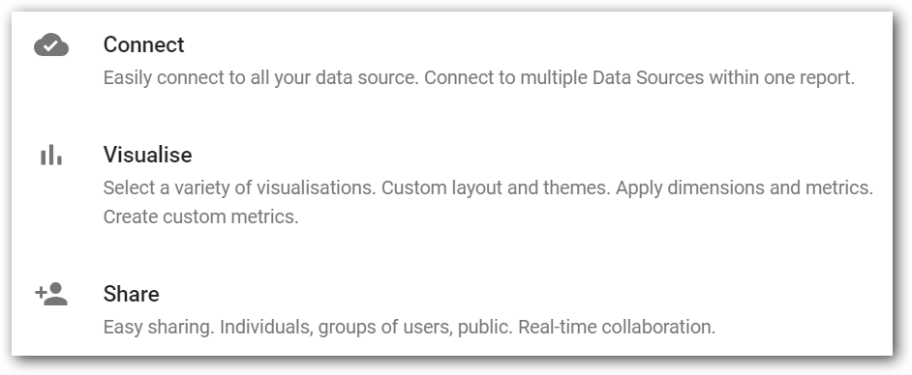

Slide 24
Play Time !!

Slide 25
Resources
PPT
https://github.com/dinesarun/
More about Bold BI
https://boldbi.com

Slide 26
Questions ??

